Slide 1
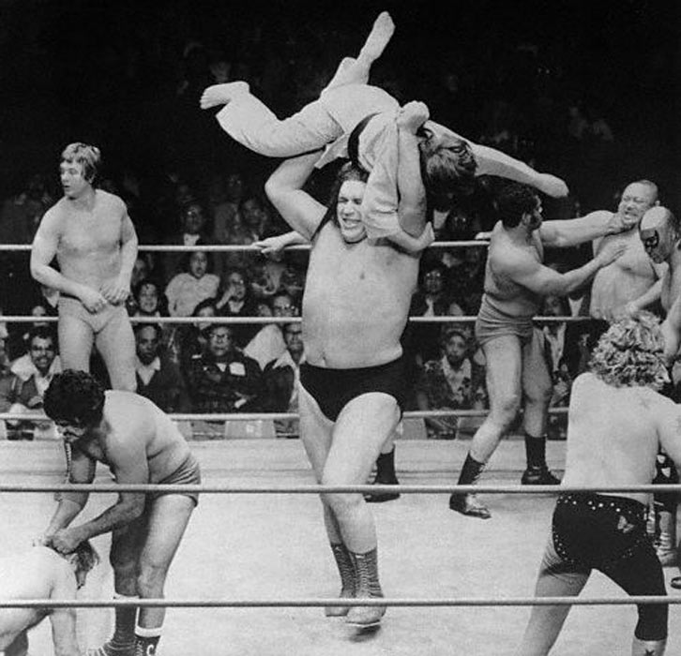
Priority Queues and Heaps
Lecture 21 (Data Structures 5)
CS61B, Spring 2024 @ UC Berkeley
Slides credit: Josh Hug
Notes:
Andre the Giant picture: Unknown source

Slide 2
Introducing the Priority Queue
Priority Queue Introduction
Introducing the Priority Queue
Using a PQ
Some Bad Implementations
Heaps
Heap Definitions
Heap Add
Heap Delete
Tree Representations
Recursive Representation (1)
Array Representations (2, 3, 3b)
Priority Queue Summary
Data Structures Summary
Lecture 21, CS61B, Spring 2024

Slide 3
The Priority Queue Interface
/** (Min) Priority Queue: Allowing tracking and removal of the
* smallest item in a priority queue. */
public interface MinPQ<Item> {
/** Adds the item to the priority queue. */
public void add(Item x);
/** Returns the smallest item in the priority queue. */
public Item getSmallest();
/** Removes the smallest item from the priority queue. */
public Item removeSmallest();
/** Returns the size of the priority queue. */
public int size();
}
Useful if you want to keep track of the “smallest”, “largest”, “best” etc. seen so far.
Notes:
Demo using a physical container, e.g. backpack

Slide 4
Using a PQ
Priority Queue Introduction
Introducing the Priority Queue
Using a PQ
Some Bad Implementations
Heaps
Heap Definitions
Heap Add
Heap Delete
Tree Representations
Recursive Representation (1)
Array Representations (2, 3, 3b)
Priority Queue Summary
Data Structures Summary
Lecture 21, CS61B, Spring 2024

Slide 5
Usage Example: Recording the Highest Energy Particles
Suppose we have a particle detector that records the energy of incoming particles.
Suppose we want to record the M highest energy particles in a given day.
Naive approach: Create a list of all particles detected during the day. Sort it using a particle energy comparator. Return the M particles that have highest energy.

Slide 6
Naive Implementation: Store and Sort
public List<Particle> highestEnergyParticles(Detector det, int M) {
ArrayList<Particle> allParticles = new ArrayList<>();
for (Timer timer = new Timer(); timer.hours() < 24; ) {
allParticles.add(det.getNextParticle());
}
Comparator<String> cmptr = new EnergyComparator();
Collections.sort(allParticles, cmptr, Collections.reverseOrder());
return allParticles.sublist(0, M);
}
Potentially uses a huge amount of memory Θ(N), where N is number of particles.

Slide 7
Naive Implementation: Store and Sort
public List<Particle> highestEnergyParticles(Detector det, int M) {
ArrayList<Particle> allParticles = new ArrayList<>();
for (Timer timer = new Timer(); timer.hours() < 24; ) {
allParticles.add(det.getNextParticle());
}
Comparator<String> cmptr = new EnergyComparator();
Collections.sort(allParticles, cmptr, Collections.reverseOrder());
return allParticles.sublist(0, M);
}
Potentially uses a huge amount of memory Θ(N), where N is number of particles.
Goal: Do this in Θ(M) memory using a MinPQ.
MinPQ<Particle> highEnergyParticles = new HeapMinPQ<>(cmptr);

Slide 8
Try to Solve Using a MinPQ
public List<Particle> highestEnergyParticles(Detector det, int M) {
Comparator<Particle> cmptr = new EnergyComparator();
MinPQ<Particle> highEnergyParticles = new HeapMinPQ<>(cmptr);
for (Timer timer = new Timer(); timer.hours() < 24; ) {
// Do something with det.getNextParticle(); ??
...
}
Potentially uses a huge amount of memory Θ(N), where N is number of particles.
Goal: Do this in Θ(M) memory using a MinPQ.
MinPQ<Particle> highEnergyParticles = new HeapMinPQ<>(cmptr);

Slide 9
Better Implementation: Track the M Best
public List<Particle> highestEnergyParticles(Detector det, int M) {
Comparator<Particle> cmptr = new EnergyComparator();
MinPQ<Particle> highEnergyParticles = new HeapMinPQ<>(cmptr);
for (Timer timer = new Timer(); timer.hours() < 24; ) {
highEnergyParticles.add(det.getNextParticle());
if (highEnergyParticles.size() > M)
{ highEnergyParticles.removeSmallest(); }
}
ArrayList<String> returnList = new ArrayList<String>();
while (highEnergyParticles.size() > 0) {
returnList.add(highEnergyParticles.removeSmallest());
}
return returnList;
}
Can track top M transactions using only M memory. API for MinPQ also makes code very simple (don’t need to make explicit comparisons).

Slide 10
Some Bad Implementations
Priority Queue Introduction
Introducing the Priority Queue
Using a PQ
Some Bad Implementations
Heaps
Heap Definitions
Heap Add
Heap Delete
Tree Representations
Recursive Representation (1)
Array Representations (2, 3, 3b)
Priority Queue Summary
Data Structures Summary
Lecture 21, CS61B, Spring 2024

Slide 11
How Would We Implement a MinPQ?
Some possibilities:
Ordered Array
Bushy BST: Maintaining bushiness is annoying. Handling duplicate priorities is awkward.
HashTable: No good! Items go into random places.
 | Ordered Array | Bushy BST | Hash Table | Heap
add | Θ(N) | Θ(log N) | Θ(1)
getSmallest | Θ(1) | Θ(log N) | Θ(N)
removeSmallest | Θ(N) | Θ(log N) | Θ(N)
Caveats |  | Dups tough
Worst Case Θ(·) Runtimes

Slide 12
Heap Definitions
Priority Queue Introduction
Introducing the Priority Queue
Using a PQ
Some Bad Implementations
Heaps
Heap Definitions
Heap Add
Heap Delete
Tree Representations
Recursive Representation (1)
Array Representations (2, 3, 3b)
Priority Queue Summary
Data Structures Summary
Lecture 21, CS61B, Spring 2024

Slide 13
Introducing the Heap
BSTs would work, but need to be kept bushy and duplicates are awkward.
Binary min-heap: Binary tree that is complete and obeys min-heap property.
Min-heap: Every node is less than or equal to both of its children.
Complete: Missing items only at the bottom level (if any), all nodes are as far left as possible.
0
0
0
0
0
5
1
5
1
5
1
5
1
8
8
6
2
8
8
8
8
8
2
8
4
6
Incomplete
Lacks min-heap property

Slide 14
Heap Comprehension Test: yellkey.com/true
How many of these are min heaps?
0
1
2
3
4
8
5
4
0
8
8
6
2
7
1
8
8
8
7
8
0
3
5
9
Notes:
https://docs.google.com/forms/d/e/1FAIpQLSf61_v4lhfyiIPAtddMbg80zQVOwknhcNENov6bq7I2w2Wzxw/viewform

Slide 15
Heap Comprehension Test
How many of these are min heaps?
0
1
2
3
4
8
5
4
0
8
8
6
2
7
1
8
8
8
7
8
0
3
5
9
Incomplete
Lacks min-heap property

Slide 16
What Good Are Heaps?
Heaps lend themselves very naturally to implementation of a priority queue.
Hopefully easy question:
How would you support getSmallest()?
0
5
1
8
8
6

Slide 17
Heap Add
Priority Queue Introduction
Introducing the Priority Queue
Using a PQ
Some Bad Implementations
Heaps
Heap Definitions
Heap Add
Heap Delete
Tree Representations
Recursive Representation (1)
Array Representations (2, 3, 3b
Priority Queue Summary
Data Structures Summary
Lecture 21, CS61B, Spring 2024

Slide 18
How Do We Add to a Heap?
Challenge: Come up with an algorithm for add(x).
How would we insert 3?
Runtime must be logarithmic.
1
3
1
6
5
5
3
7
7
8
5
6

Slide 19
Heap Add Demo
1
5
1
6
5
6
3
7
7
8
Insert 3?

Slide 20
Heap Add Demo
1
5
1
6
5
6
3
7
7
8
3
Insert 3.
Add to end of heap temporarily.

Slide 21
Heap Add Demo
1
5
1
6
5
6
3
7
7
8
3
Insert 3.
Add to end of heap temporarily.
Swim up the hierarchy to your rightful place...

Slide 22
Heap Add Demo
1
5
1
6
3
6
3
7
7
8
5
Insert 3.
Add to end of heap temporarily.
Swim up the hierarchy to your rightful place...

Slide 23
Heap Add Demo
1
3
1
6
5
6
3
7
7
8
5
Insert 3.
Add to end of heap temporarily.
Swim up the hierarchy to your rightful place...

Slide 24
Heap Add Demo
This is my true place.
1
3
1
6
5
6
3
7
7
8
5
Insert 3.
Add to end of heap temporarily.
Swim up the hierarchy to your rightful place.

Slide 25
Heap Add Demo
1
3
1
6
5
6
3
7
7
8
5
5
Insert 5.
Add to end of heap temporarily.

Slide 26
Heap Add Demo
1
3
1
6
5
6
3
7
7
8
5
5
Insert 5.
Add to end of heap temporarily.
Swim up the hierarchy to your rightful place...

Slide 27
Heap Add Demo
1
3
1
6
5
5
3
7
7
8
5
6
Insert 5.
Add to end of heap temporarily.
Swim up the hierarchy to your rightful place...

Slide 28
Heap Add Demo
1
I am home. For the first time in my life. I am home.
3
1
6
5
5
3
7
7
8
5
6
Insert 5.
Add to end of heap temporarily.
Swim up the hierarchy to your rightful place.

Slide 29
Heap Delete
Priority Queue Introduction
Introducing the Priority Queue
Using a PQ
Some Bad Implementations
Heaps
Heap Definitions
Heap Add
Heap Delete
Tree Representations
Recursive Representation (1)
Array Representations (2, 3, 3b)
Priority Queue Summary
Data Structures Summary
Lecture 21, CS61B, Spring 2024

Slide 30
How Do We Remove from a Heap?
Challenge: Come up with an algorithm for removeSmallest().
Runtime must be logarithmic.
3
5
3
6
5
5
6
7
7
8

Slide 31
Heap Delete Demo
1
3
1
6
5
5
3
7
7
8
5
6
Delete min.

Slide 32
Heap Delete Demo
1
3
1
6
5
5
3
7
7
8
5
6
Delete min.
Swap the last item in the heap into the root.

Slide 33
Heap Delete Demo
Wuh oh...
1
3
1
6
5
5
3
What’s happening to me??
7
7
8
5
6
Delete min.
Swap the last item in the heap into the root.

Slide 34
Heap Delete Demo
3
1
6
5
5
3
What’s happening to me??
7
7
8
5
6
Delete min.
Swap the last item in the heap into the root.

Slide 35
Heap Delete Demo
I’m not cut out for this...
6
Move aside, cretin.
3
1
6
5
5
3
7
7
8
5
Delete min.
Swap the last item in the heap into the root.
Then sink your way down the hierarchy, yielding to most qualified folks...

Slide 36
Heap Delete Demo
1
3
6
6
5
5
3
7
7
8
5
Delete min.
Swap the last item in the heap into the root.
Then sink your way down the hierarchy, yielding to most qualified folks...

Slide 37
Heap Delete Demo
1
3
3
6
5
5
6
7
7
8
5
Delete min.
Swap the last item in the heap into the root.
Then sink your way down the hierarchy, yielding to most qualified folks...

Slide 38
Heap Delete Demo
1
3
3
6
5
5
6
7
7
8
5
Delete min.
Swap the last item in the heap into the root.
Then sink your way down the hierarchy, yielding to most qualified folks.

Slide 39
Heap Delete Demo
3
3
6
5
5
6
ulp...
7
7
8
5
Delete min.
Swap the last item in the heap into the root.

Slide 40
Heap Delete Demo
Break tie arbitrarily.
5
3
3
6
5
5
6
7
7
8
Delete min.
Swap the last item in the heap into the root.
Then sink your way down the hierarchy, yielding to most qualified folks...

Slide 41
Heap Delete Demo
3
I won’t descend further.
5
3
6
5
5
6
7
7
8
Delete min.
Swap the last item in the heap into the root.
Then sink your way down the hierarchy, yielding to most qualified folks...

Slide 42
Recursive Representation (1)
Priority Queue Introduction
Introducing the Priority Queue
Using a PQ
Some Bad Implementations
Heaps
Heap Definitions
Heap Add
Heap Delete
Tree Representations
Recursive Representation (1)
Array Representations (2, 3, 3b)
Priority Queue Summary
Data Structures Summary
Lecture 21, CS61B, Spring 2024

Slide 43
Heap Operations Summary
Given a heap, how do we implement PQ operations?
getSmallest() - return the item in the root node.
add(x) - place the new employee in the last position, and promote as high as possible.
removeSmallest() - assassinate the president (of the company), promote the rightmost person in the company to president. Then demote repeatedly, always taking the ‘better’ successor.
Remaining question: How would we do all this in Java?

Slide 44
How do we Represent a Tree in Java?
Approach 1a, 1b and 1c: Create mapping from node to children.
w
x
y
z
w
x
y
z
1a: Fixed-Width Nodes (BSTMap used this approach)
public class Tree1A<Key> {
Key k; // e.g. 0
Tree1A left;
Tree1A middle;
Tree1A right;
...

Slide 45
How do we Represent a Tree in Java?
Approach 1a, 1b and 1c: Create mapping from node to children.
w
x
y
z
public class Tree1B<Key> {
Key k; // e.g. 0
Tree1B[] children;
...
w
x
y
z
1b: Variable-Width Nodes

Slide 46
How do we Represent a Tree in Java?
Approach 1a, 1b and 1c: Create mapping from node to children.
w
public class Tree1C<Key> {
Key k; // e.g. 0
Tree1C favoredChild;
Tree1C sibling;
...
x
y
z
w
x
y
z
1c: Sibling Tree

Slide 47
How do we Represent a Tree in Java?
Approach 1a, 1b and 1c: Create mapping from node to children.
w
x
y
z
w
w
x
y
z
x
y
z
1a: Fixed-Width Nodes
1b: Variable-Width Nodes
w
x
y
z
1c: Sibling Tree

Slide 48
Array Representations (2, 3, 3b)
Priority Queue Introduction
Introducing the Priority Queue
Using a PQ
Some Bad Implementations
Heaps
Heap Definitions
Heap Add
Heap Delete
Tree Representations
Recursive Representation (1)
Array Representations (2, 3, 3b)
Priority Queue Summary
Data Structures Summary
Lecture 21, CS61B, Spring 2024

Slide 49
How do we Represent a Tree in Java?
Approach 2: Store keys in an array. Store parentIDs in an array.
Similar to what we did with disjointSets.
w
x
y
z
public class Tree2<Key> {
Key[] keys;
int[] parents;
...
Key[] keys
w
x
y
z
int[] parents
0
0
0
0
0 1 2 3
Key[] keys
0
k
k
e
v
b
g
p
y
a
d
f
j
m
r
x
1
2
0 1 2 3 4
5 6 7 8 9 10 11 12 13
e
v
3
4
5
6
int[] parents
b
g
p
y
7
0
0
0
1
1
2
2
3
3
4
4
5
5
6
a
d
f
j
m
r
x
8
9
10
11
12
13
0 1 2 3 4
5 6 7 8 9 10 11 12 13

Slide 50
How do we Represent a Tree in Java?
Approach 3: Store keys in an array. Don’t store structure anywhere.
To interpret array: Simply assume tree is complete.
Obviously only works for “complete” trees.
w
x
y
z
public class Tree3<Key> {
Key[] keys;
...
Key[] keys
w
x
y
z
0 1 2 3
Key[] keys
0
k
k
e
v
b
g
p
y
a
d
f
j
m
r
x
1
2
0 1 2 3 4
5 6 7 8 9 10 11 12 13
e
v
3
b
4
g
5
p
6
y
7
a
d
f
j
m
r
x
8
9
10
11
12
13

Slide 51
A Deep Look at Approach 3
Challenge: Write the parent(k) method for approach 3.
w
public void swim(int k) {
if (keys[parent(k)] ≻ keys[k]) {
swap(k, parent(k));
swim(parent(k));
}
}
x
y
z
Key[] keys
w
x
y
z
0 1 2 3
Key[] keys
0
k
k
e
v
b
g
p
y
a
d
f
j
m
r
x
1
2
0 1 2 3 4
5 6 7 8 9 10 11 12 13
e
v
3
4
5
6
public class Tree3<Key> {
Key[] keys;
...
b
g
p
y
7
a
d
f
j
m
r
x
8
9
10
11
12
13

Slide 52
A Deep Look at Approach 3
Challenge: Write the parent(k) method for approach 3.
w
public void swim(int k) {
if (keys[parent(k)] ≻ keys[k]) {
swap(k, parent(k));
swim(parent(k));
}
}
x
y
z
Key[] keys
w
x
y
z
0 1 2 3
public int parent(int k) {
return (k - 1) / 2;
}
Key[] keys
0
k
k
e
v
b
g
p
y
a
d
f
j
m
r
x
1
2
0 1 2 3 4
5 6 7 8 9 10 11 12 13
e
v
3
4
5
6
public class Tree3<Key> {
Key[] keys;
...
b
g
p
y
7
a
d
f
j
m
r
x
8
9
10
11
12
13

Slide 53
Tree Representations (Summary)
w
w
w
x
y
z
x
y
z
x
y
z
1a: Fixed Number of Links (One Per Child)
1b: Array of Child Links
w
Key[] keys
w
x
y
z
Key[] keys
int[] parents
w
x
y
z
x
y
z
0
0
0
0
0 1 2 3
3: Array of Keys
1c: FirstBorn/Sibling Links
2: Array of Keys, Array of Structure

Slide 54
Approach 3B (book implementation): Leaving One Empty Spot
Approach 3b: Store keys in an array. Offset everything by 1 spot.
Same as 3, but leave spot 0 empty.
Makes computation of children/parents “nicer”.
leftChild(k) = k*2
rightChild(k) = k*2 + 1
parent(k) = k/2
w
x
y
z
Key[] keys
-
w
x
y
z
0 1 2 3 4
Key[] keys
1
k
-
k
e
v
b
g
p
y
a
d
f
j
m
r
x
2
3
0 1 2 3 4
5 6 7 8 9 10 11 12 13 14
e
v
4
b
5
g
6
p
7
y
8
a
d
f
j
m
r
x
9
10
11
12
13
14

Slide 55
Priority Queue Summary
Priority Queue Introduction
Introducing the Priority Queue
Using a PQ
Some Bad Implementations
Heaps
Heap Definitions
Heap Add
Heap Delete
Tree Representations
Recursive Representation (1)
Array Representations (2, 3, 3b)
Priority Queue Summary
Data Structures Summary
Lecture 21, CS61B, Spring 2024

Slide 56
Heap Implementation of a Priority Queue
 | Ordered Array | Bushy BST | Hash Table | Heap
add | Θ(N) | Θ(log N) | Θ(1) | Θ(log N)
getSmallest | Θ(1) | Θ(log N) | Θ(N) | Θ(1)
removeSmallest | Θ(N) | Θ(log N) | Θ(N) | Θ(log N)
Notes:
Why “priority queue”? Can think of position in tree as its “priority.”
Heap is log N time AMORTIZED (some resizes, but no big deal).
BST can have constant getSmallest if you keep a pointer to smallest.
Heaps handle duplicate priorities much more naturally than BSTs.
Array based heaps take less memory (very roughly about 1/3rd the memory of representing a tree with approach 1a).
Items with same priority hard to handle.

Slide 57
Some Implementation Questions
How does a PQ know how to determine which item in a PQ is larger?
What could we change so that there is a default comparison?
What constructors are needed to allow for different orderings?
/** (Min) Priority Queue: Allowing tracking and removal of the
* smallest item in a priority queue. */
public interface MinPQ<Item> {
/** Adds the item to the priority queue. */
public void add(Item x);
/** Returns the smallest item in the priority queue. */
public Item getSmallest();
/** Removes the smallest item from the priority queue. */
public Item removeSmallest();
/** Returns the size of the priority queue. */
public int size();
}

Slide 58
Data Structures Summary
Priority Queue Introduction
Introducing the Priority Queue
Using a PQ
Some Bad Implementations
Heaps
Heap Definitions
Heap Add
Heap Delete
Tree Representations
Recursive Representation (1)
Array Representations (2, 3, 3b)
Data Structures Summary
Lecture 21, CS61B, Spring 2024

Slide 59
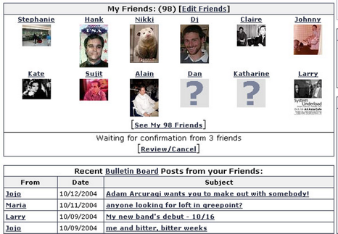
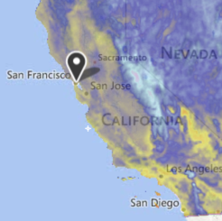
The Search Problem
Given a stream of data, retrieve information of interest.
Examples:
Website users post to personal page. Serve content only to friends.
Given logs for thousands of weather stations, display weather map for specified date and time.
Notes:
Friendster screenshot: http://jeremy.zawodny.com/i/friendster_rss.jpg
Weather screenshot: weather.com

Slide 60
Search Data Structures (The particularly abstract ones)
Name | Storage Operation(s) | Primary Retrieval Operation | Retrieve By:
List | add(key) insert(key, index) | get(index) | index
Map | put(key, value) | get(key) | key identity
Set | add(key) | containsKey(key) | key identity
PQ | add(key) | getSmallest() | key order (a.k.a. key size)
Disjoint Sets | connect(int1, int2) | isConnected(int1, int2) | two int values

Slide 61
Diagram of Data Structures and ADTs (past semester version)
Heap
Stack
Chaining HT
Balanced Tree
Linear Probing HT
Ordered Linked List
PQ
Set
LinkedList
Chaining HT (lacks order, very odd)
Resizing Array
Map
LinkedList
BST (Vanilla)
List
Resizing Array
Red Black
B-Trees (2-3 / 2-3-4)
Quick Find
Quick Union
Heap
DisjointSets
Weighted QU
WQUPC

Slide 62
Diagram of Data Structures and ADTs (past semester version)
Abstraction often happens in layers!
PQ
Heap Ordered Tree
Separate Chaining HT
Array of Buckets
Approach 1A
ArrayList
Approach 1B
Bucket
Resizing Array
Tree
Approach 1C
LinkedList
Approach 2
BST (requires comparable items)
Approach 3
HashSet (weird choice)
Approach 3B

Slide 63
Diagram of Data Structures and ADTs (past semester version)
Specialized Searching Data Structures:
Stack
Linked List
List
Queue
Resizing Array (slightly suboptimal due to resizing)
Deque
In Java:
java.util.SortedSet
java.util.SortedMap
Set
Sorted Set
BST
2-3 Tree
Map
Sorted Map
RedBlack
Don’t usually consider MinPQ and MaxPQ to be different data structures, since we can just provide the opposite comparator.
PQ

Slide 64
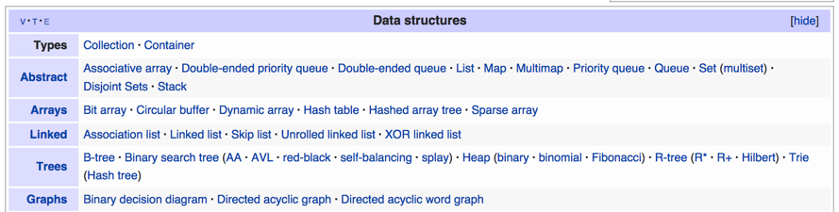
Data Structures
Data Structure: A particular way of organizing data.
We’ve covered many of the most fundamental abstract data types, their common implementations, and the tradeoffs thereof.
We’ll do two more in this class:
Tries, graphs.

